Slide 1
Software Systems Design and Integration
Week 1
Introduction
1-<number>

Slide 2
LECTURE PLAN
    Distributed Systems - Definition
    Distributed Systems - Classification
    Distributed Systems – Fallacies &
    Challenges
    Distributed Systems - Issues
1-<number>

Slide 3
Formal Definition
‘A collection of probably heterogeneous automata whose distribution is transparent to the user so that the system appears as one local machine.‘
[Textbook]
1-<number>

Slide 4
Less Formal Definition
A distributed system is a system in which the failure of a computer you’ve never heard of can prevent you from getting your work done …
[IT folklore]
1-<number>

Slide 5
Working Definition
‘A distributed system is a collection of entities, each of which is autonomous, programmable, reactive and failure-prone, and communicating through an unreliable communication medium’.
The entities:
  Components (Component Software Engineering)
  Systems (Information Systems Engineering)
  Services (Service-oriented & Cloud-based Systems)
1-<number>
Notes:
Designers and progammers interested in : algorithmics, maintenance.
(informal definition, for us programmers of distributed systems)
Ok: peer to peer systems
Contradiction: a computer without ROM or disk drives that needs to boot over the network. Is a collection of these computers a distributed system?

Slide 6
Essential features of the distribution
The distribution is physical, not virtual – the system is distributed in several locations
The heterogeneity means that the separate parts of the distributed system can reside on different platforms (i.e., local computer, remote server, cloud portal, portable laptop, mobile phone, etc.)
The transparency of distributed systems is in contrast to working on a single application within a network, where the user is aware that there are several machines, and their location, storage replication, load balancing and functionality is not transparent.
1-<number>

Slide 7
LECTURE PLAN
    Distributed Systems - Definition
    Distributed Systems – Classification
    Distributed Systems - Fallacies &
    Challenges
    Distributed Systems - Issues
1-<number>

Slide 8
Can you name some examples of
Distributed Systems?
The Internet as such and the World Wide Web
An ad-hoc wireless network (i.e., SAS team in action)
A sensor network (i.e., sensors of the ocean currents)
Distributed File System (Novell NFS, Hadoop HDS, etc.)
Internet Domain Name Service (DNS)
Google Maps (distributed databases with location-specific information)
Kaazaa, BitTorrent (peer to peer overlays of computers over the Internet)
1-<number>

Slide 9
Examples of Distributed Systems
The Internet
  network of networks
  global access to “everybody”
    (data, services, other actors)
  enormous size
    - open ended
  no single authority
    - decentralized
  communication types
    interrogation (question/answer), announcement (publish/subscribe), stream (broadcasting)
    text, binary data, audio, video
1-<number>

Slide 10
Internet Topology
intranet
ISP
backbone
satellite link
desktop:
server:
network link:

Slide 11
Internet Applications Protocols
Application
layer protocol
SMTP
Telnet, SSL
HTTP, HTTPS
FTP
RTSP, proprietary
NFS, AFS, …
H.323, SIP, …
Underlying
transport protocol
TCP
TCP
TCP
TCP
TCP or UDP
TCP or UDP
typically UDP
Application
e-mail
remote terminal access
Web, cloud
file transfer
streaming multimedia
remote file server
Internet telephony
1-<number>

Slide 12
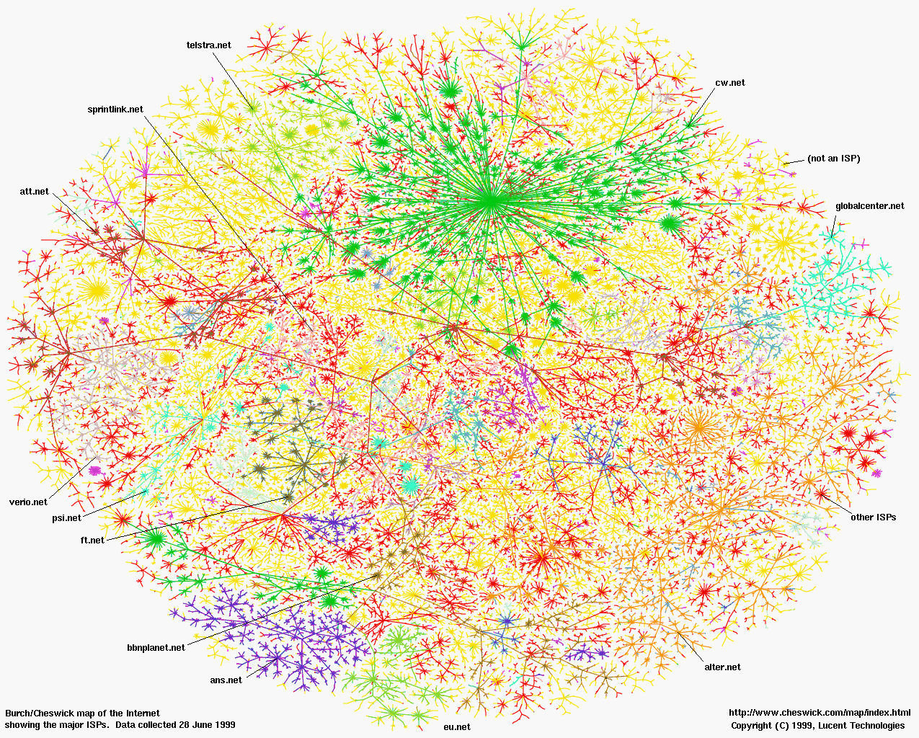
2D map of the Internet by ISPs
1-<number>

Slide 13
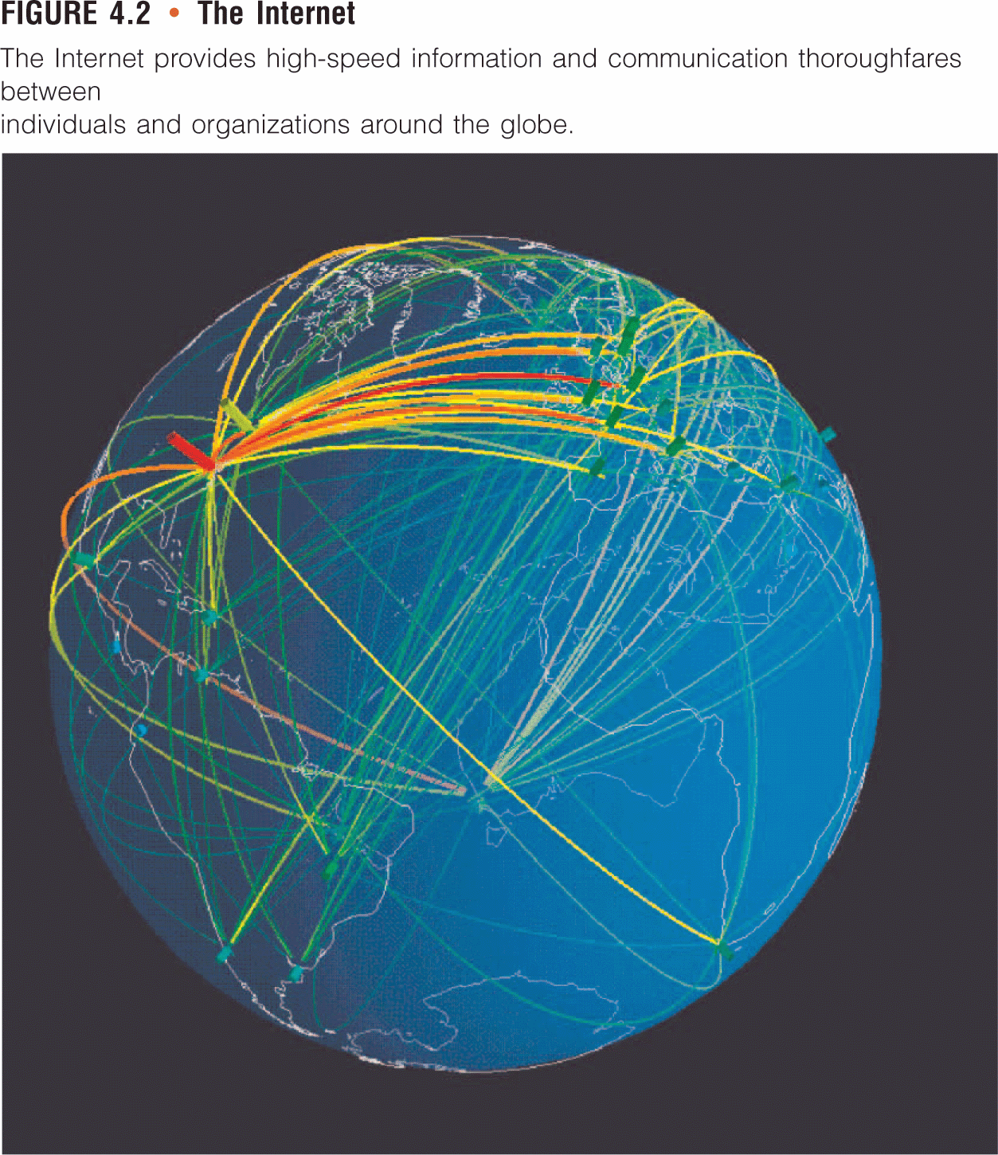
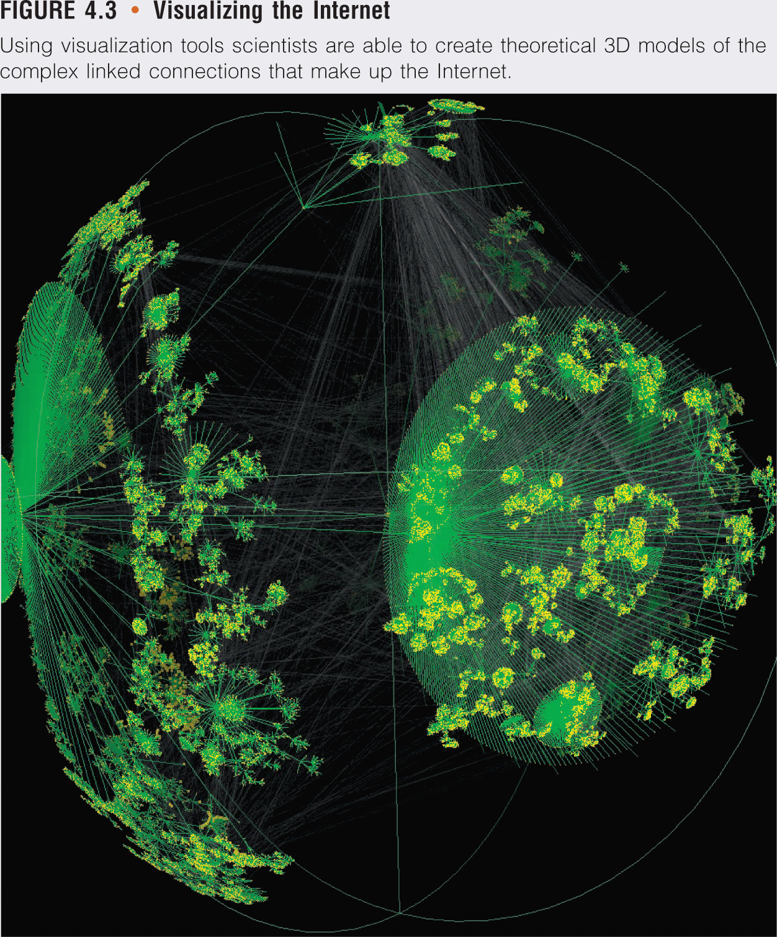
3D Model of the Internet by connections
1-<number>

Slide 14

Examples of Distributed Systems
World Wide Web
HTTP: Hypertext Transfer Protocol
WWW’s application layer protocol
client/server model
  client: browser that requests, receives, and “displays” WWW objects
  server: WWW server sends objects in response to requests
HTTP 1.0: RFC 1945 (1996)
HTTP 1.1: RFC 2068 (1997)
http request
PC running
Internet Explorer
http response
http request
Server
Running
cnn.com
Web
server
http response
Mac running
Safary
1-<number>

Slide 15
HTTP Protocol
HTTP: TCP transport service
client initiates a TCP connection (creates socket) to server, port 80
server accepts the TCP connection from client
http messages (application-layer protocol messages) exchanged between browser (HTTP client) and WWW server (HTTP server)
TCP connection closed
HTTP is “stateless”
server maintains no information about past client requests
Protocols that maintain “state” are more complex (i.e., IIOP)
past history (state) must be maintained
if server/client crashes, their views of “state” may be inconsistent, and hence must be reconciled.
1-<number>

Slide 16
Dynamics of the Growth of Web Servers
Date
Computers
Web servers
Percentage
1993, July
1,776,000
130
0.008
1995, July
6,642,000
23,500
0.4
1997, July
19,540,000
1,203,096
6
1999, July
56,218,000
6,598,697
12
2001, July
125,888,197
31,299,592
25
2003, Jan
171,638,297
35,424,956
21
2005, July
353,284,187
67,571,581
19
2006, Jan
394,991,609
74,951,256
19
2007, Jan
439,286,364
106,875,138
24
2008, Jan
541,677,360
155,561,813
29
2008, July
570,937,778
176,748,506
31
1-<number>

Slide 17
Examples of Distributed Systems
Intranets
Composed of several local area networks (LANs) linked by backbone connections.
One dedicated intranet server controls the traffic in and out the intranet.
Typically the communications within the intranet use HTTP protocol
A firewall is used to protect an intranet by preventing unauthorized message leaving/entering, implemented by filtering incoming/outgoing messages.
1-<number>

Slide 18
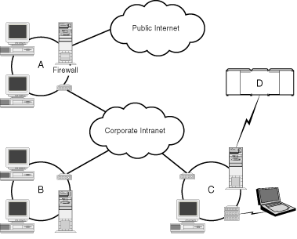
Intranet Topology
1-<number>

Slide 19
Examples of Distributed Systems
VPNs and extranets
VPN (Virtual Private Network) use dedicated communication channels/protocols
Typically they have their own infrastructure (client/server architecture)
Extranets use public channels of communication
Extranets are composed of several intranets linked to the Internet using routers. They are not directly connected to each other and typically use HTTP/HTTPS protocol
Dedicated servers maintains information about the users of local intranets and the extranet (directory servers)
Dedicated servers may control the access to the local intranets from the other intranets (access server)
1-<number>

Slide 20
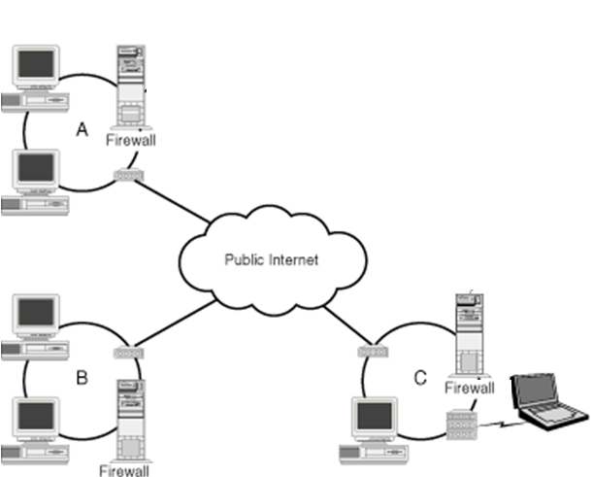
Extranet topology
1-<number>

Slide 21
Examples of Distributed Systems
Cloud-based Systems
The physical distribution of the parts of the system (local and remote) is combined with logical distribution (virtualization)
The architecture of the cloud-based distributed systems is a simple client/server architecture where the server-side is a distributed system itself
The cloud-based systems use the standard Web communication protocols (HTTP, HTPS)
The clouds hide the physical distribution on the client side (hence the term cloud)
Popular clouds: Dropbox, iTunes, youTube, Amazon, etc.
1-<number>

Slide 22
Examples of Distributed Systems
Portable, Mobile, Ubiquitous & Pervasive
Portable computing
  portable computers (laptops), handheld devices (palmtops) and active screen devices (tablets)
  portable communication devices (smartphones, walkie-talkies, voice-controlled devices)
  wearable objects (glasses, watches, tags, etc.)
  devices embedded in home appliances (fridges, TV sets, etc)
Mobile computing
  Location-aware devices (GPS-enabled drones, missiles, etc.)
Ubiquitous computing
  large number of small cooperative devices with computing and/or communication capabilities (i.e., IP-cameras, temperature sensors, etc.)
Pervasive computing
  embedding in day-to-day objects (i.e., cars, Alexa, etc.)
1-<number>

Slide 23
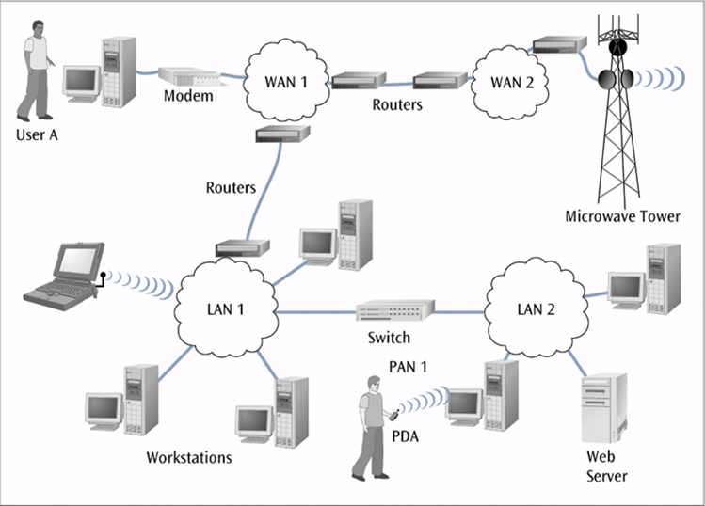
Portable devices in a distributed system
1-<number>

Slide 24
Examples of Distributed Systems
Embedded Systems
Avionics control systems
  Flight management systems in aircraft: sensors, controllers, local processors, central board computer
Automotive control systems
  Mercedes S class cars these days are equipped with up to 200 autonomous embedded processors
  Connected through proprietary bus-like LANs
  Flying and submerging drones
Consumer electronics
  Audio HiFi equipment with wireless connections between the devices (Bluetooth)
1-<number>

Slide 25
LECTURE PLAN
    Distributed Systems - Definition
    Distributed Systems - Classification
    Distributed Systems - Fallacies &
    Challenges
    Distributed Systems - Issues
1-<number>

Slide 26
Distributed Systems – 8 Fallacies
The network is reliable.
Latency is zero.
Bandwidth is infinite.
The network is secure.
Topology doesn't change.
There is one administrator.
Transport cost is zero.
The network is homogeneous
1-<number>

Slide 27
How to account them
Be prepared
  Murphy’s Law: “If something wrong may happen it will definitively happen”
  My own principle: “If something goes ok, there is a hidden error which will manifest itself at certain point”
Estimate the risks and the cost
Optimize the measures to minimize the cost
1-<number>

Slide 28
Distributed Systems – 9 Challenges
Heterogeneity – can it handle different types of PCs and devices?
Resilience – is the system robust to cope with crashes & failures?
Availability – are data, services always there?
Transparency – can it hide its internal workings from the users?
Concurrency – can server handle multiple clients simultaneously?
Efficiency – is it fast enough?
Scalability – can it handle 100 million nodes?
Security – can the system withstand hacker attacks?
Openness – is the system extensible?
1-<number>

Slide 29
Heterogeneity
Heterogeneity of
  networks
  computer hardware
  operating systems
  programming languages
  implementations of different developers
Portability, interoperability of hardware devices (desktops, laptops, palmtops/smartphones)
Mobile code, adaptability of software applications (applets, aglets)
Middleware (RMI, CORBA, etc)
1-<number>

Slide 30
Openness
Openness is concerned with allowing extensions and improvements to distributed systems (extensible).
Detailed interfaces of components need to be published.
New components have to be integrated with existing components.
Differences in data representation of interface types on heterogeneous processors have to be resolved.
Standardised communication protocols
1-<number>

Slide 31
Security
Security: Confidentiality, Integrity, Availability
Vulnerable components
    channels (links <–> end-to-end paths)
    processes (clients, servers)
Threats
    information leakage
    integrity violation
    denial of service
    illegitimate usage
Current issues:
    DoS attacks, security of mobile code, information flow; open wireless ad-hoc environments
1-<number>

Slide 32
Scalability
The system will remain effective when there is a significant increase in the
  number of resources
  number of users
The architecture and implementation must allow automatic scaling up and down
The algorithms must be efficient under all expected circumstances
Example: Server duplication & load balancing, hot-swap memory management in databases
1-<number>

Slide 33
Resilience
Fault avoidance vs. Fault tolerence - More components => increased fault rate
Increased possibilities
  redundancy => more possibilities for fault tolerance
  decentralization => no fatal failure
Issues
  Detecting failures
  Masking failures
  Recovery from failures
  Tolerating failures
  Redundancy
New issues: partial failures
1-<number>

Slide 34
Concurrency
Components in distributed systems are executed in concurrent processes.
Several simultaneous users => integrity of data
  mutual exclusion, synchronization
  ext: transaction processing in data bases
Components access and update shared resources.
Replicated data: consistency of information?
Integrity of the system may be violated if concurrent updates are not coordinated.
Order of messages - No global clock!
1-<number>

Slide 35
Transparency
Application Transparency
Scalability
Transparency
Performance
Transparency
Failure
Transparency
Mobility
Transparency
Replication
Transparency
Concurrency
Transparency
Platform Transparency
Access
Transparency
Location
Transparency
MediaTransparency
1-<number>

Slide 36
LECTURE PLAN
    Distributed Systems - Definition
    Distributed Systems - Classification
    Distributed Systems – Fallacies &
    Challenges
    Distributed Systems - Issues
1-<number>

Slide 37
Distributed Systems Issues
No global clock; no single global notion of the correct time (requires synchronisation)
Unpredictable failures of components: lack of response may be due to either failure of a network component, network path or a computer crash (failure-prone)
Highly variable bandwidth (varying speed)
Possibly large and variable latency (unpredictable delays)
Large numbers of hosts (increasing complexity)
1-<number>

Slide 38
Summary
  What we have covered in this lecture:
  Definition of Distributed Systems
  Classification of Distributed Systems
  Fallacies and Challenges of Distributed Systems
  Issues with Distributed Systems
  Next Week we will cover:
  Distributed Models and Architectures
1-<number>

